Slide 1
Library Management System
Sydney Lieske

Slide 2
Overview
The database is for a library's catalog of books, noting which ones are available and information about the book, such as:
Author
Publisher
Number of copies available
Title
ISBN
Genre
Section in the library
Borrowed date and return date
This database is available to the librarians, assistant librarians, and library members.
Each has their own ID number (an EMPID and a MemberID, respectively).
Members have an account with their date of birth, username, and password.
Workers at the library have a libraryID, JobID, and JobType.

Slide 3
Business Rules
1. Each author can write 1 or more books.
2. Each member can have many checkouts.
3. One librarian can work at 1 book register.
4. Each book can have many copies.
5. Each book can be published by 1 publisher.
6. Each section is located at a library.
7. Many employees can work at a library.
8. Each library can employ many employees.
9. Each employee has 1 job.
10. Each library uses member accounts.

Slide 4
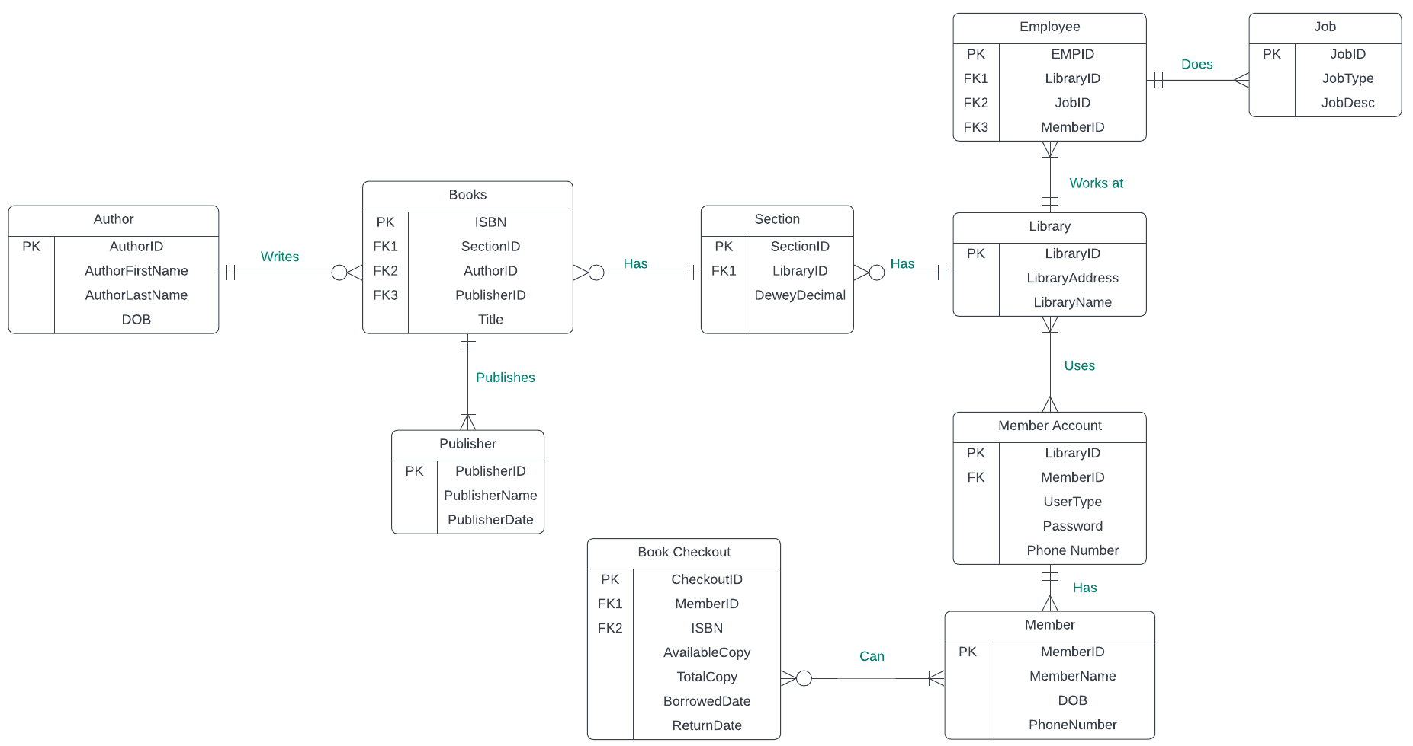
ER Diagram & Explanation

Slide 5
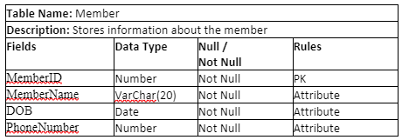
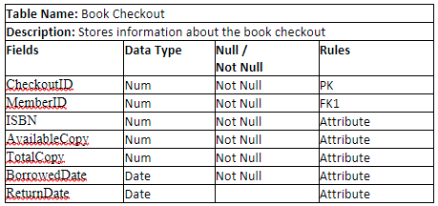
Data Dictionary

Slide 6
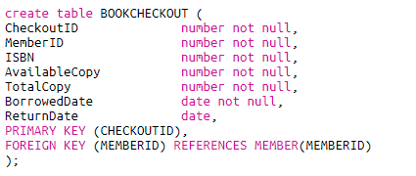
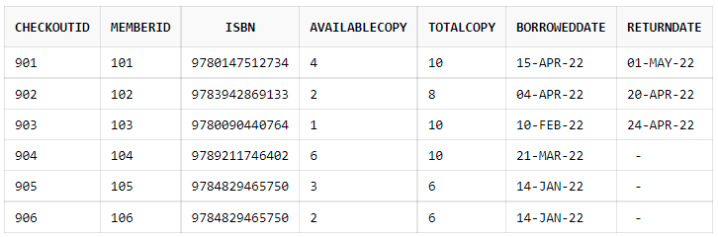
Creating Tables

Slide 7

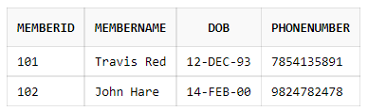
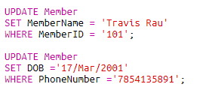
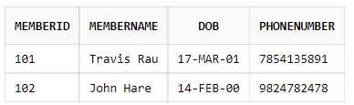
Insert & Update

Slide 8
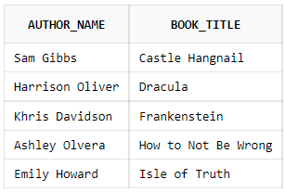
Queries
Selects the name of a book along with the name of the author who wrote it

Slide 9
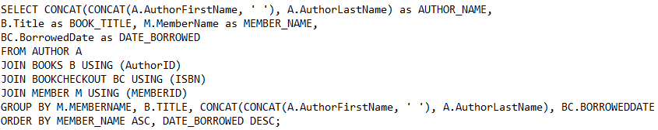
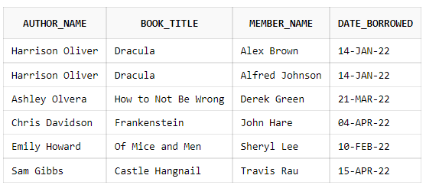
Queries
Selects the Author name, book name, member name, and the date of all books that have been checked out

Slide 10
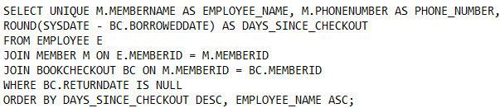

Queries
Selects the name and phone number of each employee who has not returned a book along with how long ago the
book was checked out

Slide 11
Questions

